Slide 1
Sentiment Analysis using Multinomial and Bernoulli Naïve Bayes

Slide 2
Multinomial Naïve Bayes

Slide 3
Sentiment Analysis using Multinomial NB

Slide 4
Dataset

Slide 5
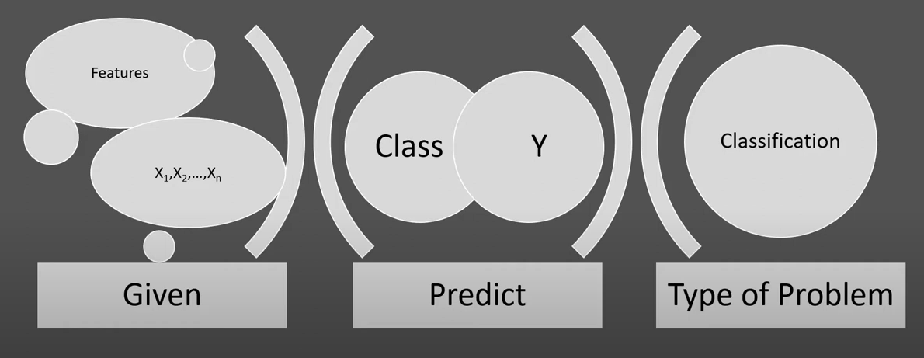
Sentiment Analysis using Multinomial NB

Slide 6
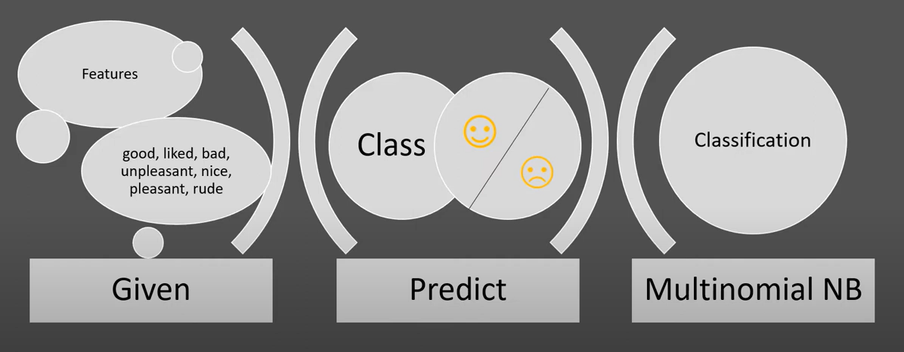
Sentiment Analysis using Multinomial NB

Slide 7
Sentiment Analysis using Multinomial NB

Slide 8
Sentiment Analysis using Multinomial NB

Slide 9
Sentiment Analysis using Multinomial NB

Slide 10
Sentiment Analysis using Multinomial NB

Slide 11
Sentiment Analysis using Multinomial NB

Slide 12
Sentiment Analysis using Multinomial NB

Slide 13
Sentiment Analysis using Multinomial NB

Slide 14
Sentiment Analysis using Multinomial NB

Slide 15
Sentiment Analysis using Multinomial NB

Slide 16
Bernoulli Naïve Bayes

Slide 17
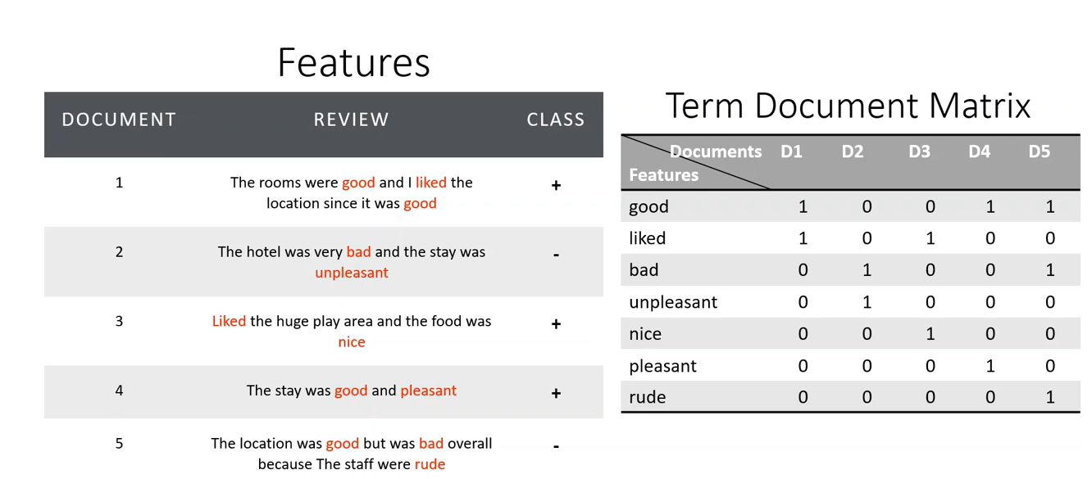
Sentiment Analysis using Bernoulli NB

Slide 18
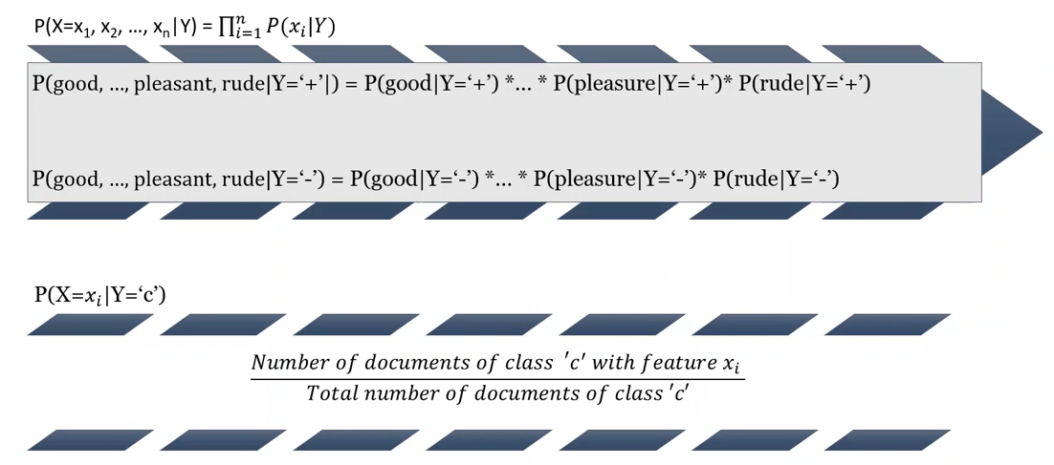
Sentiment Analysis using Bernoulli NB

Slide 19
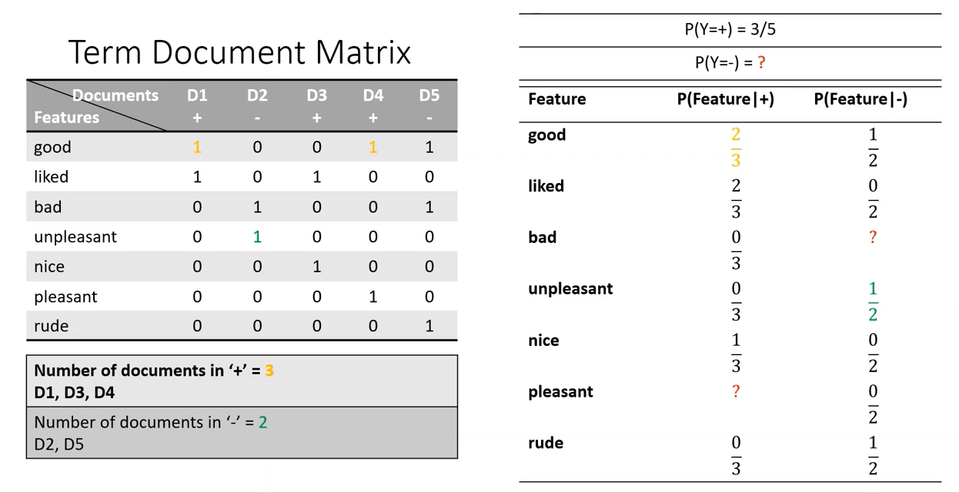
Sentiment Analysis using Bernoulli NB

Slide 20
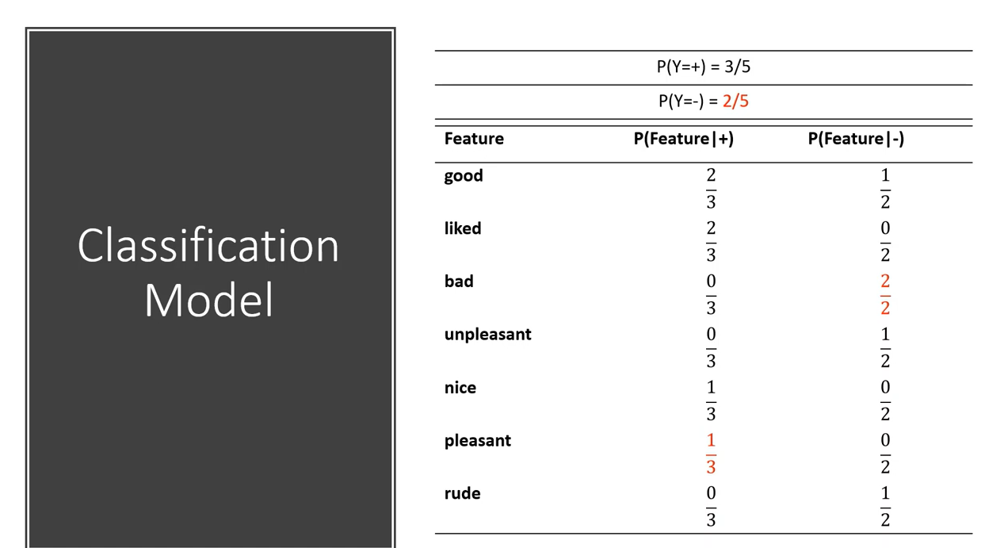
Sentiment Analysis using Bernoulli NB

Slide 21
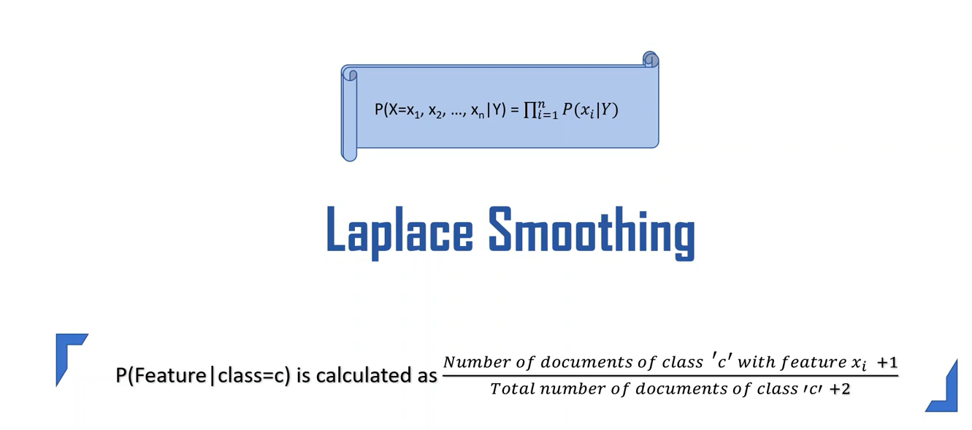
Sentiment Analysis using Bernoulli NB

Slide 22
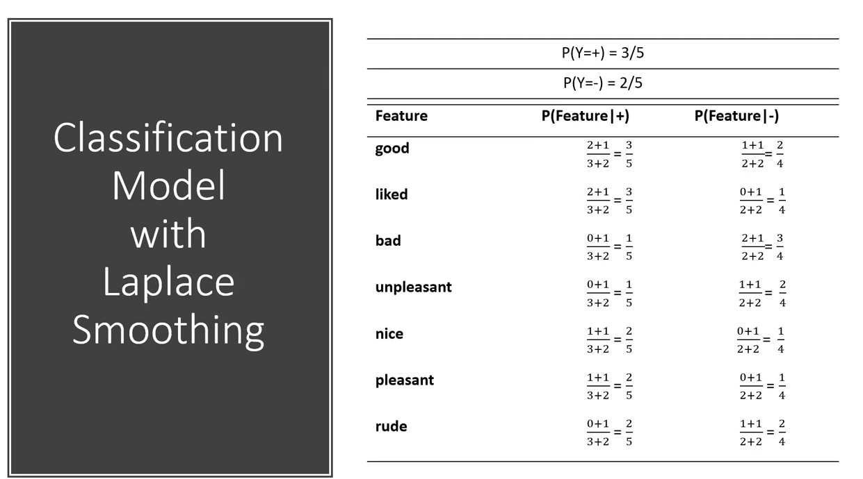
Sentiment Analysis using Bernoulli NB

Slide 23
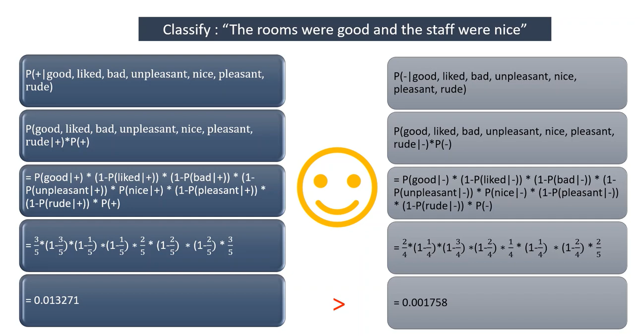
Sentiment Analysis using Bernoulli NB

Slide 24
